Slide 1
Operating System Lab # 02 Linux Commands and Shell Scripting
Prepared by : Engr. Rahemeen Khan

Slide 2
Linux Commands
S# | COMMAND | PURPOSE
 | cp | Copy file or directory
2. | mv | Move file or directory
3. | rm | Remove file
4. | mkdir | Create directory
5. | rmdir | Removes (empty) directories
6. | rm -r | Remove full content directory
7. | pwd | Displays the name of the current working directory
8. | who | Displays the number of users logged on particular system.
9. | whoami | Display username
10. | uname | System information
11. | groups | Shows all groups
12. | cal | Displays calendar
13. | sleep | This command does nothing for the number of seconds specified as the argument.
14. | shutdown | Turn off machine or reboot

Slide 3
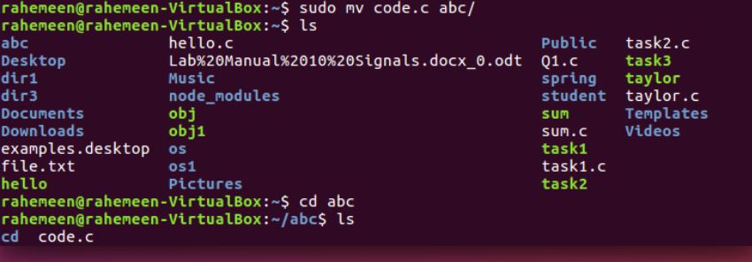
Example 1
Copying a single file to a destination directory:
$ cp data.txt /var/tmp/
Example 2
Copying multiple files to a destination directory:
$ cp data.txt file.csv /var/tmp/

Slide 4
C language in Linux
Some of the variable types that can be declared in C are as follows:
char c;
int i;
long l;
float f;
double d;

Slide 5
Declaring variables along and the increment/decrement operations.
#include <stdio.h>
int main()
{
int x, n = 10, z;
x = n++;
z = ++n;
printf("The value of x = %d\n", x);
printf("The value of z = %d\n", z);
return 0;
}

Slide 6
#include <stdio.h>
#define LIMIT 50
int main()
{
int age;
printf("Hello, please enter your age!\n");
scanf("%d", &age);
if(age < LIMIT)
{
printf("Your age is %d.\n", age);
printf("Still young!!\n");
}
else if(age == LIMIT)
{
printf("Your age is %d.\n", age);
printf("Almost there.\n");
}
else
{
printf("Your age is %d.\n", age);
printf("You are a senior!\n");
}
return 0;
}

Slide 7
Shell Scripting in Linux
Shell script is a file containing a series of commands. The shell reads this file and carries out the commands as though they have been entered directly on the command line.
To create a shell script, you need to use a text editor, such as gedit, and save the commands file with the .sh extension.
Every new line in a shell script is considered as a new command.
Comments are defined in a shell script by placing the # symbol before the commented line.

Slide 8
Open a text editor and write the following code:
#!/bin/bash
# My first script
echo "Hello World!“
Save the file using a suitable name such as my_script.sh. In order to run a shell script, you need to invoke the shell and pass the file name as a parameter, as given in the example below:
$ bash my_script.sh
Another way is to execute the scripts like a program. For that, the script needs to have the proper permissions. You can make the script executable by running the following command:
$chmod 755 my_script.sh
As a result of the above process, the script can be executed by the following command:
$ ./my_script.sh

Slide 9
Lab Activity
Question # 01:
Practice all the Linux commands discussed in this lab while taking assistance using the man command. Write the complete syntax used for utilizing the cp, mv and rm commands in Linux shell.
Question # 02:
Write the C programs provided in this lab and generate their outputs over Linux environment (provide snapshot).
Question # 03:
Write a C program on the Linux environment that takes your marks as an input and display your grades accordingly to that followed at Bahria University. Limit your program to a maximum of five subjects. Use the suitable logical operator(s), i.e. and (&&), or (||), not (!), if required.
Question # 04:
Write a shell script to display your address over multiple lines.
Question # 05:
Write a shell script that would traverse among any three directories that are placed under the /home directory. While moving from one directory to another, the script should display the name of the current working directory and list the content within that directory, including the hidden files.

